Slide 1
Dr. Wim Elving, Professor of Sustainable Communication
The war for Talent

Slide 2
Agenda
My personal journey into Employer Branding
@Hanze
Antonia Hein
Talent in the Region

Slide 3
My personal journey
2010 contacted by a recruitment agency
Started with a content analysis of existing vacancies
Remarkable, only the logo told us which company it was
Standard texts used in almost all vacancies
No 9 – 5 mentality
Hands on competencies
Good communication skills
No information on the unique identity of the organization or the unique people working in that organization…

Slide 4
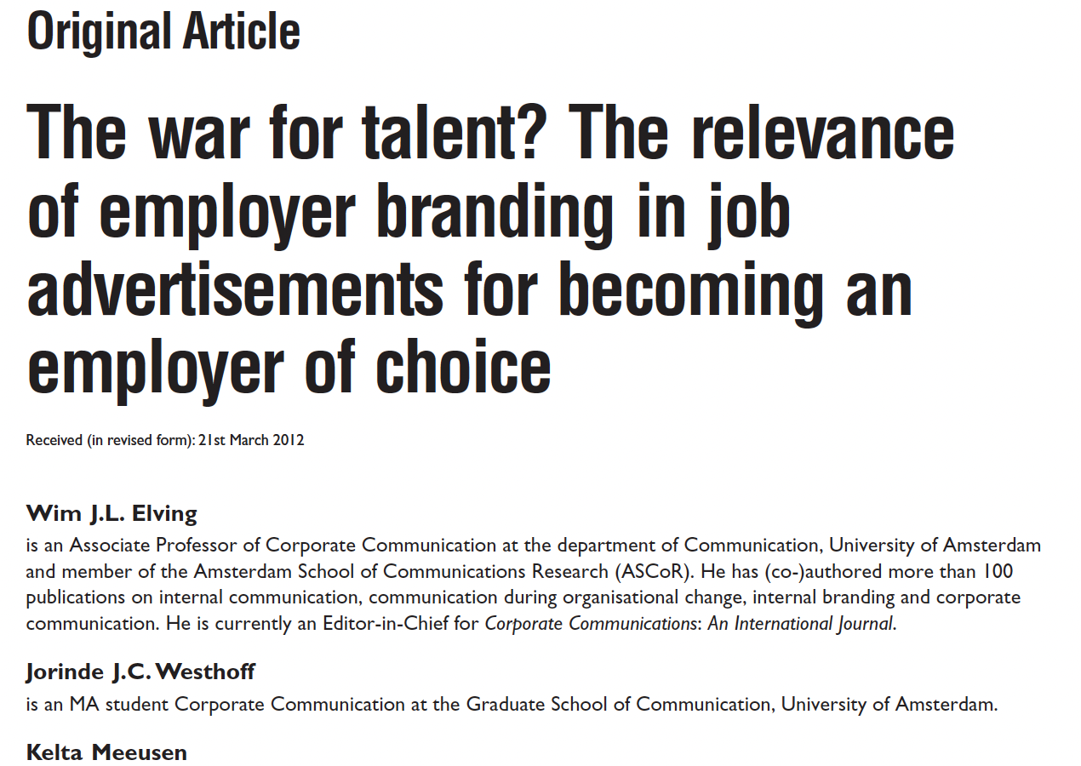
Experiment
Branded versus non branded (standard vacancies) vacancy tekst
Not only very significant difference, but also about 15 students from the experimental condition who read the branded text that really wanted the name of the organization, because they wanted to work over there
Journal of Brand Management (2013) 20, 355 – 373. doi: 10.1057/bm.2012.21 ;

Slide 5
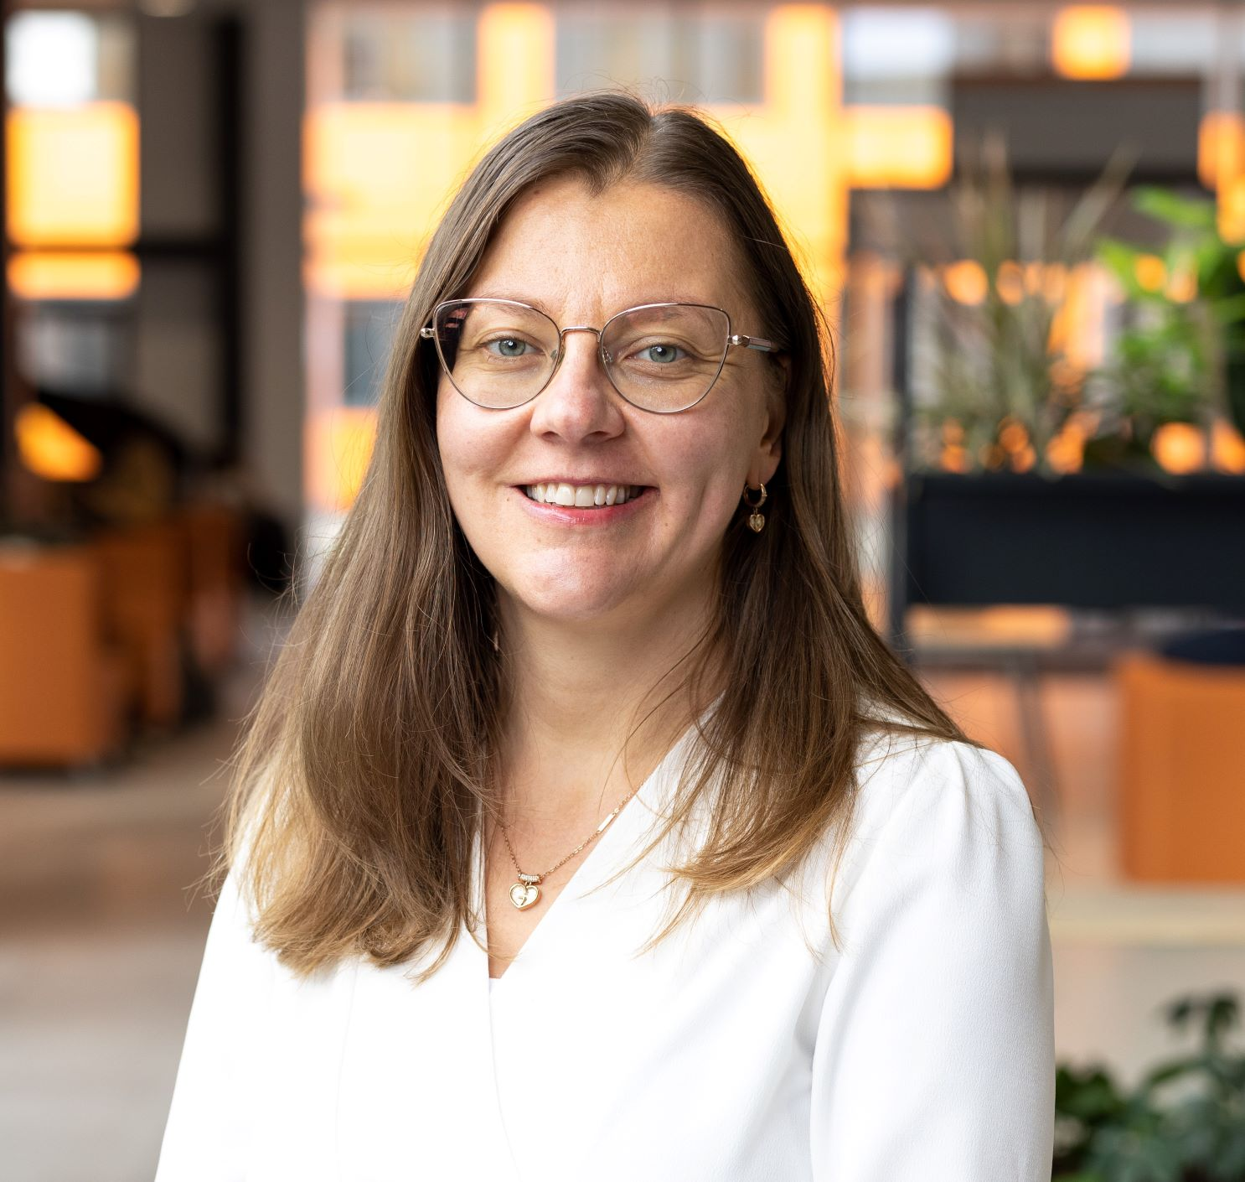
Antonia Hein
One of the teachers International Communication
Did do projects and research on the attractiveness of IT companies
Wanted to obtain a PhD

Slide 6
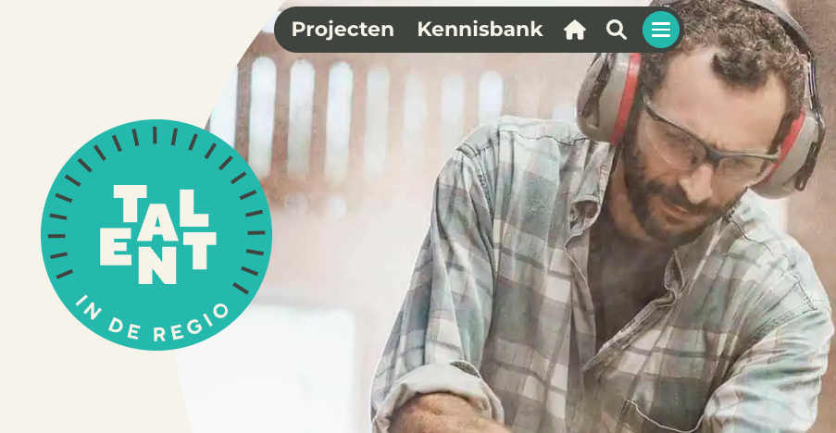
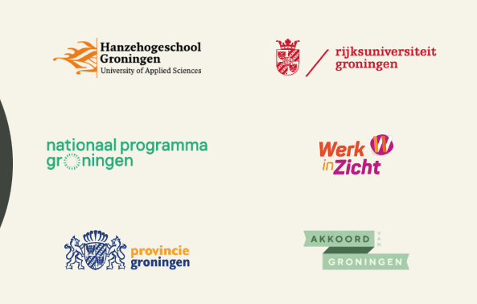
Regional project: Talent in the Region
Groningen region suffers from the gas extraction, that lead to earthquakes, with a lot of damages, dysfunctioning governments and a changing labor market
Several programs aimed at reinforcing the region; National Program Groningen offers a variety of project, among these is Talent in the Region

Slide 7
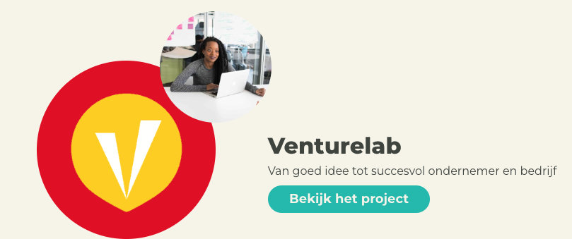
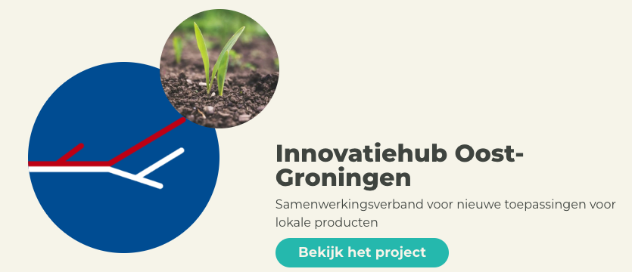
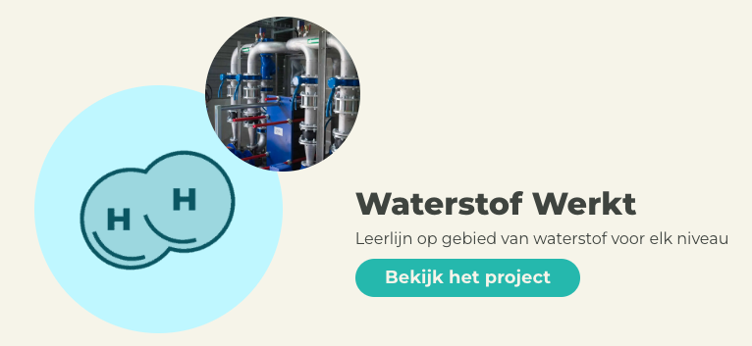
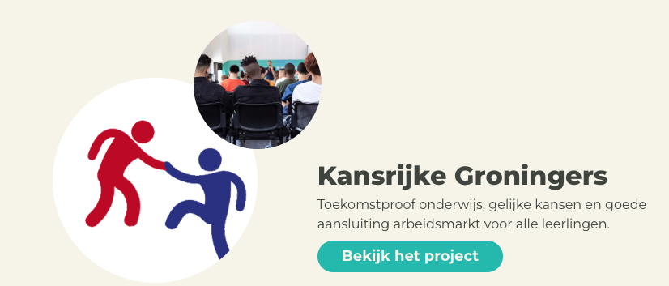
Projects
ETC.

Slide 8
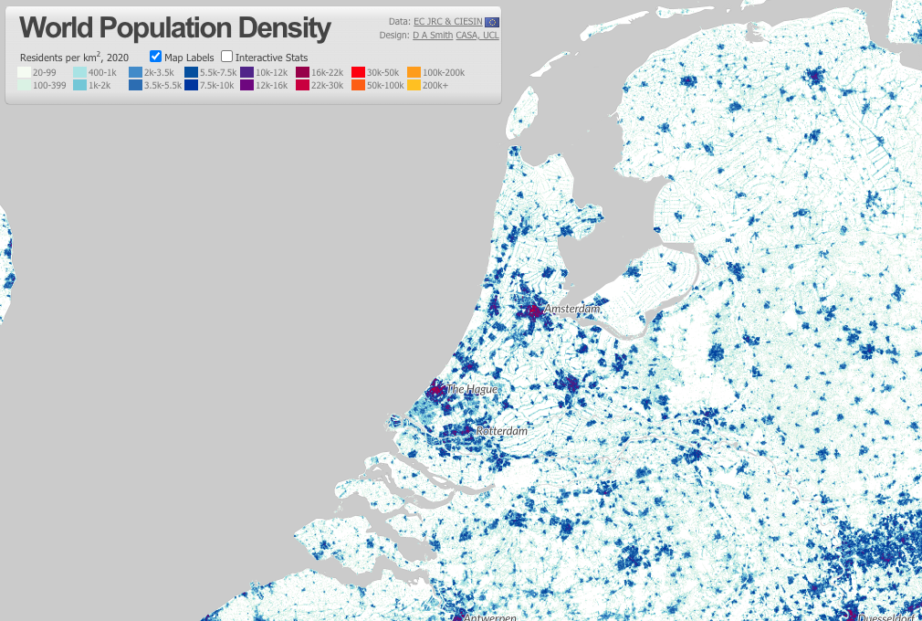
Groningen
Dutch call this region de Randstad, including the big 4 cities, Amsterdam, Rotterdam, The Hague & Utrecht
Sundsvall
Randstad attracts many students, a lot of work, all the national government is present, and also a lot international organizations

Slide 10
Talent in the region main goal
How to keep the talents that graduate from Universities in the North
Focus on three industries; IT, Energy & Health Care
Antonia’s PhD started in 2020 (4 years)
Experiment like the old study from 2013
Content analysis
Large multilevel study with
Interviews of responsible managers (n=26)
Questionnaires on the employees of those 26 organizations (n=950)

Slide 11
https://doi.org/10.1108/CCIJ-07-2022-0070
Experimental study, 2x2 design, Employer Branding or not and Location (Groningen versus Amsterdam)
Fun result; among Dutch population Amsterdam is superior, however, for the international students Amsterdam didn’t had this image

Slide 12
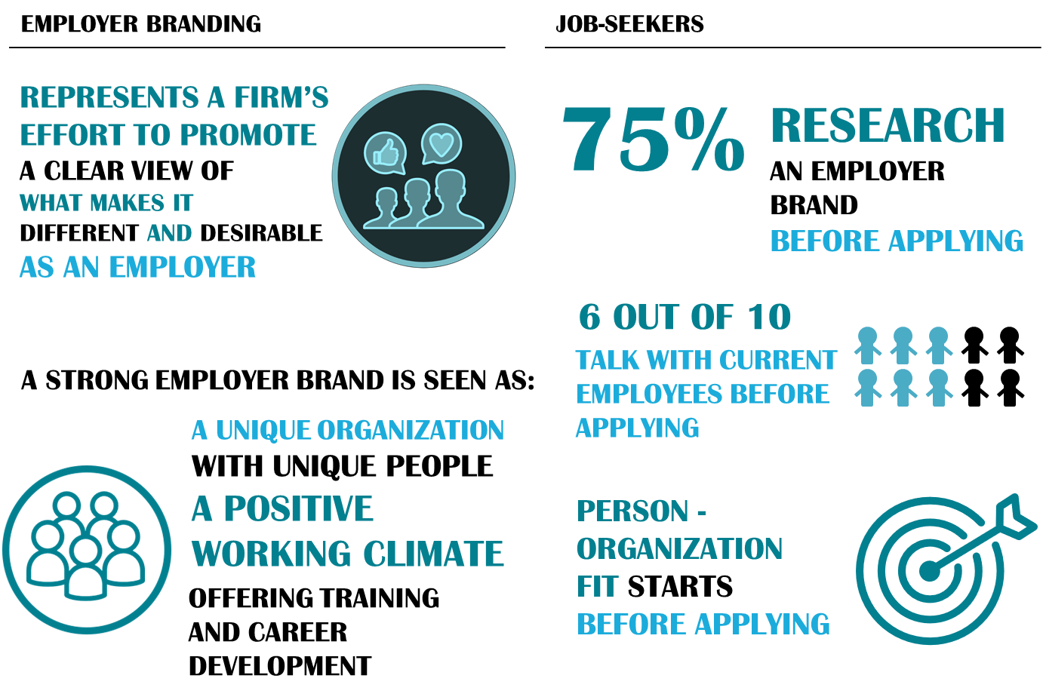

Slide 13
Content Analysis
Quantitative content analysis
113 Dutch vacancies from the North (IT, Energy, Healthcare)
113 from comparable regions abroad (Germany, Bulgaria)
Posted on leading recruitment sites
Targeting highly-educated graduates/professionals
Sample – equal amount in each industry and country
Emerging coding: level 1 and 2
Why Germany & Bulgaria?
Germany looks a lot like the Netherlands
Bulgaria is booming on IT
Availability of students from the Master International Communication*
* One of them won the Entrance Student award for best thesis!

Slide 14
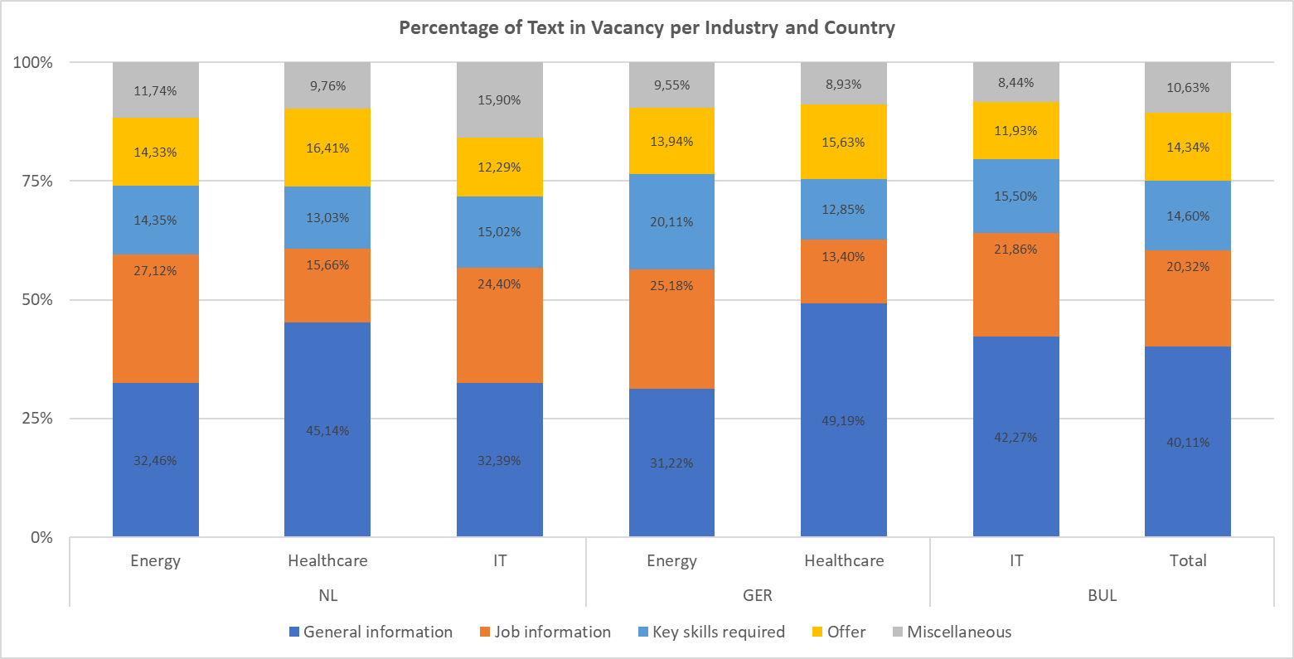
Results: percentage tekst in vacancies

Slide 15
Frequency of codes per country

Slide 16
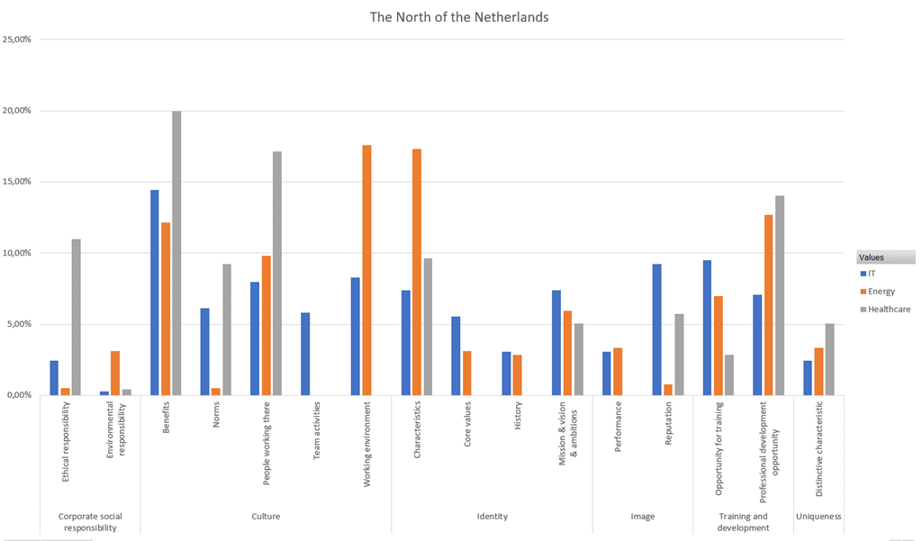
Employer Branding elements

Slide 17
Comparison three Branches
IT | Energy | Healthcare
Outgoing (extras about the office, social events, outings) Characteristics – business terms, company specializations and value Image- leadership, partners and clients Benefits and career growth emphasized People and norms (freedom, flexibility, challenge boldly stated) | Traditional framing Factual on characteristics, technology, infrastructure Benefits (travel allowance) and professional development emphasized Little on diversity, equal opportunities, inclusion, hardly any image and reputation Interesting terms mentioned: employee contributes to energy transition (generally) WE (“informal”, “safe and responsible,” NOT “diverse”) Competitive vs. honest, leader vs. social, confident vs. connecting/caring | Procedural Characteristics -Location important, department information Benefits and professional development emphasized Limited core values or history Expertise of people working there

Slide 18
Study 3
Selected several organizations in the three branches (IT, Energy & Healthcare)
Two parts:
Interview (26) with the responsible manager (brand manager, HR manager, communication manager or sometimes owner/ chair)
Questionnaire to all employees of participating organizations (N= 950)

Slide 19
Benchmark for organizations that joined in study

Slide 20
Diversity & Inclusion
Be honest and open about the reality
Work on your engagement – transparancy, communication & Employee Voice
Current (NL) | D&I
Active, enthusiastic, energetic | Diverse team, friendly, collaborative, emphasis on team
Many projects, development within the organization | Equal opportunities for training, growth
Innovation, technology, performance | You are essential to our development, concrete examples how
Competitive, leader, confident | Honest, social, connecting, team player

Slide 21
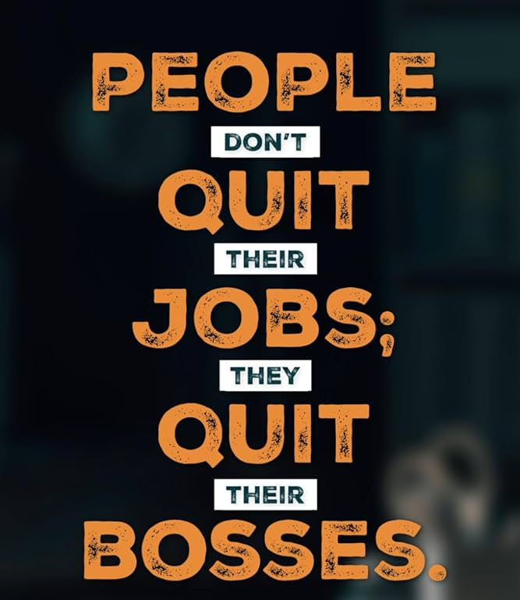
Results two papers (in progress, accepted for Euprera & CSR communication conference)
Employer Branding and Internal communication are strongly linked
The internal part of Employer Branding
In line with previous results: job-seekers will start with a LinkedIn search of who they know at the company that is offering a job
Employees that use Internal Social Media are more committed to company than those who don’t
Employees do care & find it important that company is social active (CSR)

